Slide 1

Community Relations Committee
November 27, 2013

Slide 2
Draft DDP & Operational Plan
Accomplishments
&
Key Learnings

Slide 3
Accomplishments
PARTNERSHIP FUND
Winter Turns up the Fun
Tourism Indicator Framework
FUEL & FUN
explorers’ edge brand
Fall Blue
STRATEGY & PROCESS
lean staff
Social Media
governance & transparency
operator engagement & awareness
Explore the Edge

Slide 4
Collaboration is key …
Strategic Collaboration
    Introduce significant, strategic partnerships to move the needle forward
    Collaboration does work when leveraged properly it introduces momentum
OTMPC
Fall Blue, 60k investment
FedNor
Port Loring, 45k
Northern OTMPC
Ride the Edge
Outdoor Journal Radio

Slide 5
Programs, Product & Marketing
In-house control is optimal
Expert Support
    e.g. strategist & media buyer

Slide 6
OUR Best work arrives when we …
1. Start with the consumer (consumer insight)
2. Ask “what is going to make it easy for the traveler to choose our destination?”
That’s how we got:
Fall Blue, Fuel & Fun, Ride the Edge, etc.

Slide 7
To leverage strategic collaborations to develop strategies, programs, products and communications that significantly increase the volume of visitors
to the region.

Slide 8
To get travelers to stay in Explorers’ Edge over and over again by creating the desire to do so and by making it easy for them to choose this region over any other.

Slide 9
Industry-Centric Philosophy
RTOs
Chamber, ED, DMO
OTMPC & RTU
Operator(s)
Intermittent programs
Intermittent collaboration
Multiple Stakeholder Agendas
One-offs
No Momentum to double tourism receipts
Lack of cohesive vision & strategy to attract travelers
Notes:
We attempted to try and figure out how to make this theoretical system work and more importantly how to make it work locally this industry centric philosophy did not result in a major impact or momentum.

Slide 10

Consumer-Centric Regional APPLICATION
leverage significant strategic
COLLABORATION
CREATE / INNOVATE
PRODUCE RESULTS
Airlines
CTC
lead the market with
create desire
RTOs
Strategies
Packages
Programs
Products
Positioning
Communications
Make it easy for travellers to visit again & again
OPERATORS
OTMPC
DMOs
Sub-regions
Greater volume of transactions
Destination Building

Slide 11
LEAD * COLLABORATE * INNOVATE * PRODUCE RESULTS

Slide 12
Questions & Discussion

Slide 13
Regional and Provincial Event Update

Slide 14
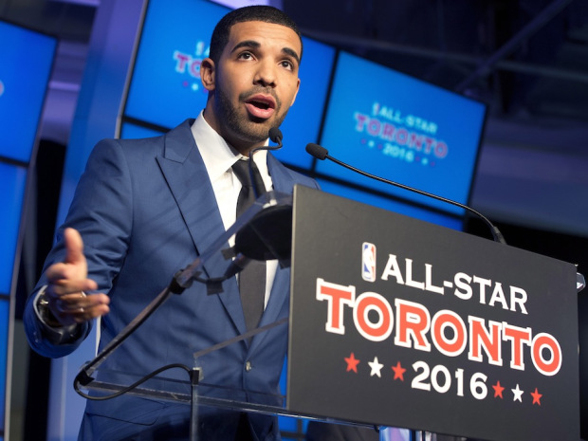


Provincial Events
2014 Winter Games
Extended Stay Packages
Programming

Slide 15
Questions & Discussion

Slide 16
Partnership Programs

Slide 17
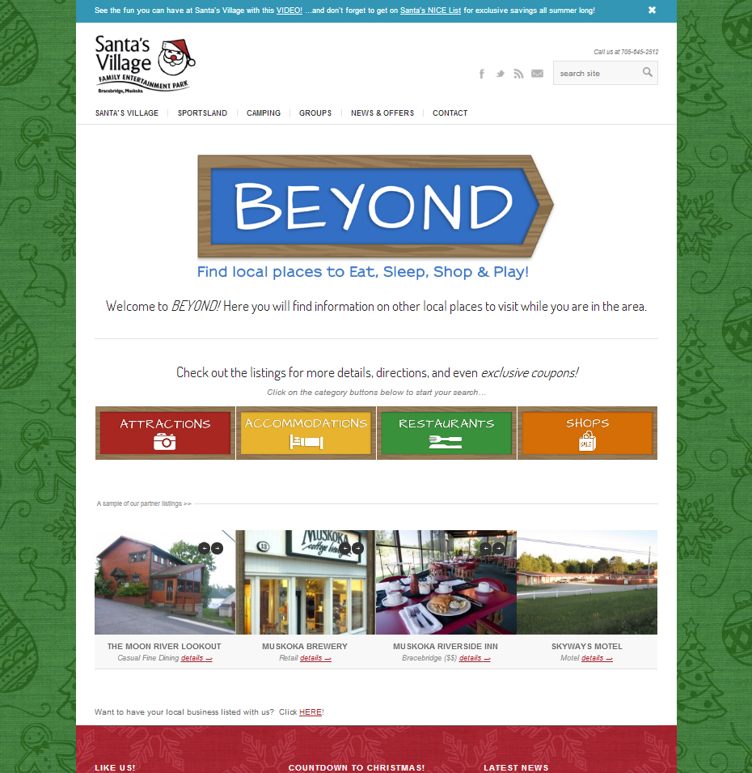
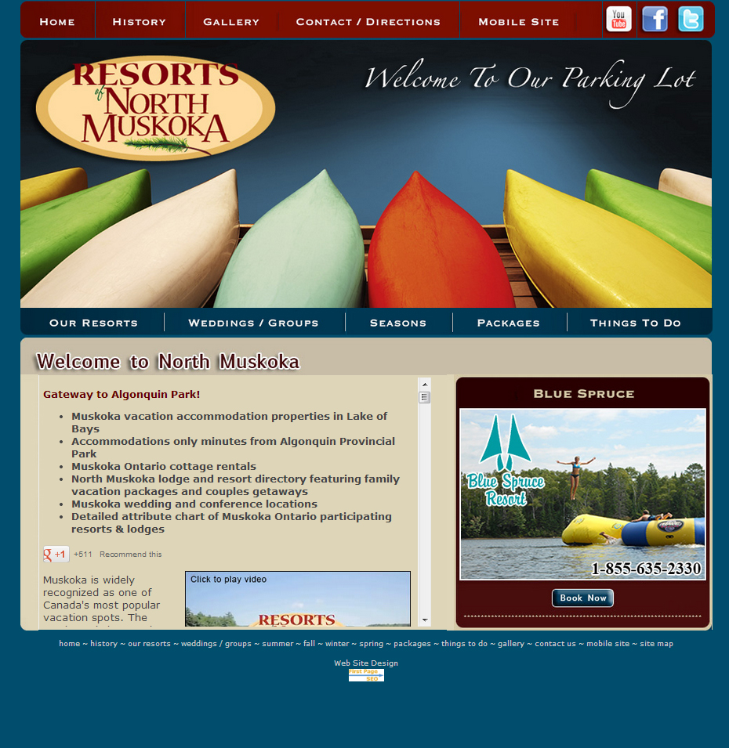
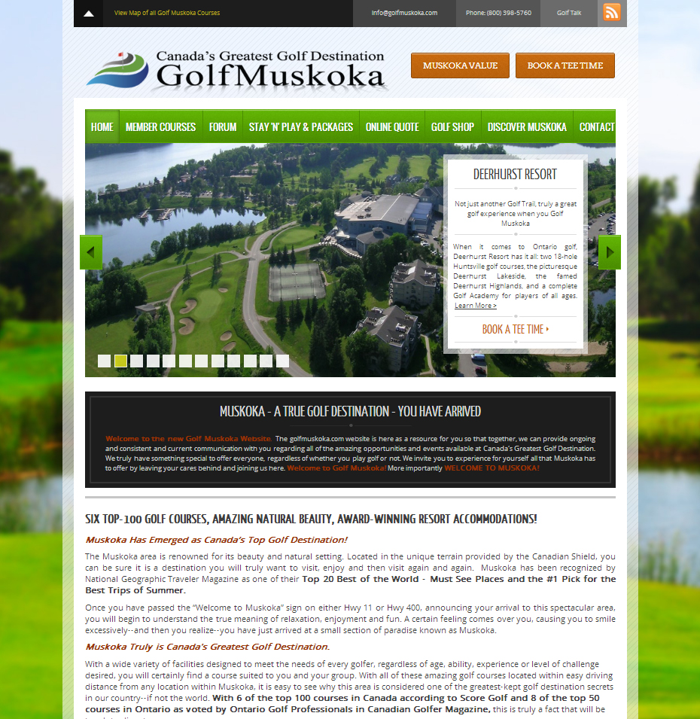
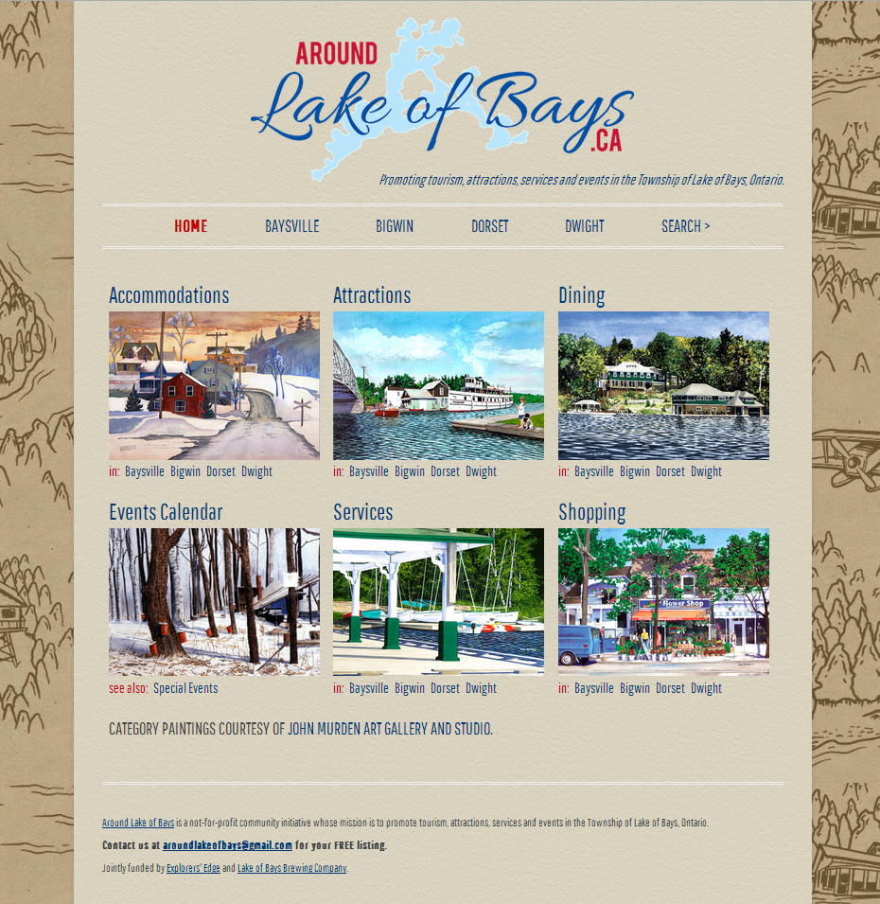
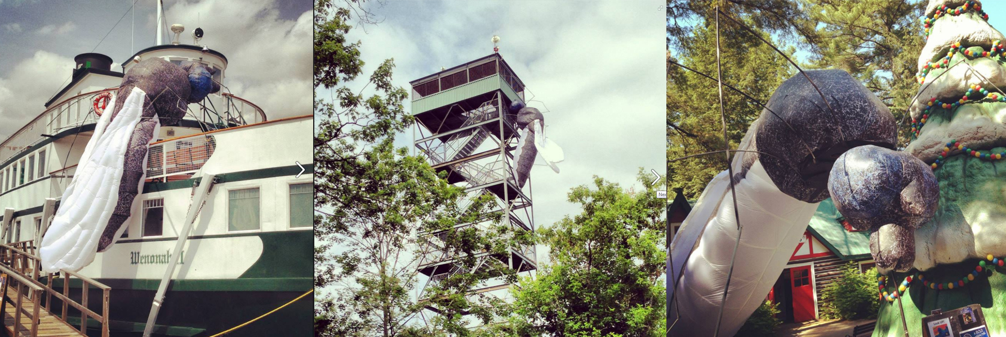
Partnership
Program
Santas Village and Muskoka Fleet
Resorts of North Muskoka
Stockey Centre – Town of Parry Sound
Lake of Bays Brewery
Tri-Muskoka
Town of Bracebridge
Golf Muskoka
JW Marriot Resort and Spa
Muskoka Festival of the Arts
Muskoka Chautauqua
Business Plans were excepted in January 2013.
Committee of the board reviewed the plans.
Put into the marketplace April 1, 2013
Align with strategy:
Building shoulder season
Changing perceptions
Engaging multiple operators
Creating new audiences

Slide 18
Partnership Program Update
15 Partnership Programs
Organizations & Stakeholders
166k
Business Applications

Slide 19
Questions & Discussion

