Slide 1
Ontario Casino Tourism Statistics 2015
Fall 2017

Slide 2
This report summarizes key characteristics of visitors and visitor spending of trips in Ontario which included going to a casino Data was sourced from Statistics Canada’s Travel Survey of the Residents of Canada and International Travel Survey, 2015 Some slides include an index table which simplifies the comparison of Casino and total trip statistics. Since total trips equals 100, an index of 105 indicates Casino is 5% higher than total, similarly an index of 90 signifies Casino is 10% lower than total. Index Interpretation less than 80 Casino trips underdeveloped versus total trips 80-120 Casino trips similar to total trips greater than 120 Casino trips overdeveloped versus total trips
2

Slide 3
Visits and Spending
Region | Visits (millions) | Visitor Spending ($ billions)
Ontario Total | 141.9 | 25.4
Ontario Casino | 3.6 | 1.5
Ontario Casino proportion of Ontario Total | 2.5% | 5.8%
In 2015, there were 3.6 million Casino visits in Ontario, representing 2.5% of total visits in Ontario
Casino visitors spent $1.5 billion, accounting for 5.8% of total visitor spending in Ontario
Source: Statistics Canada’s Travel Survey of the Residents of Canada and International Travel Survey 2015; Ontario Ministry of Tourism, Culture and Sport

Slide 4
Casino and Total Visits by Origin
Casino vs. Total | Visit Index
Ontario | 77
U.S. | 301
Other Canada | 91
Overseas | 341
Ontario residents accounted for the majority of Casino (66%) and total (86%) visits
U.S. visitors accounted for 24% of Casino visits compared to 8% of total visits
Visitors from Other Canada comprised 4% of Casino visits and 5% of total visits
Overseas visitors accounted for 6% of Casino visits and 2% of total visits
Source: Statistics Canada’s Travel Survey of the Residents of Canada and International Travel Survey 2015; Ontario Ministry of Tourism, Culture and Sport

Slide 5
Casino and Total Spending by Origin
Casino vs. Total | Spending Index
Ontario | 64
U.S. | 190
Other Canada | 61
Overseas | 149
Ontario residents accounted for 35% of Casino and 55% of total spending
U.S. visitors accounted for 27% of Casino spending compared to 14% of total spending
Visitors from Other Canada comprised 6% of Casino spending and 9% of total spending
Overseas visitors accounted for 32% of Casino spending and 22% of total spending
Source: Statistics Canada’s Travel Survey of the Residents of Canada and International Travel Survey 2015; Ontario Ministry of Tourism, Culture and Sport

Slide 6
Ontario Casino Visitors by Region of Residence
Casino vs. Total | Visits from Ontario Index
Reg 1 | 123
Reg 2 | 47
Reg 3 | 87
Reg 4 | 80
Reg 5 | 155
Reg 6 | 114
Reg 7 | 66
Reg 8 | 63
Reg 9 | 41
Reg 10 | 50
Reg 11 | 32
Reg 12 | 58
Reg 13 | 96
34% Casino visitors from Ontario are from Region 5 compared to 22% of total visits, 16% from Region 6 (14% total visits), and 14% from Region 1 (12% total visits)
Note: Ontario origin Casino visitors represented 65% (2.4 million) of visits and 35% ($517 M) of visitor spending
Source: Statistics Canada’s Travel Survey of the Residents of Canada and International Travel Survey 2015; Ontario Ministry of Tourism, Culture and Sport
6

Slide 7
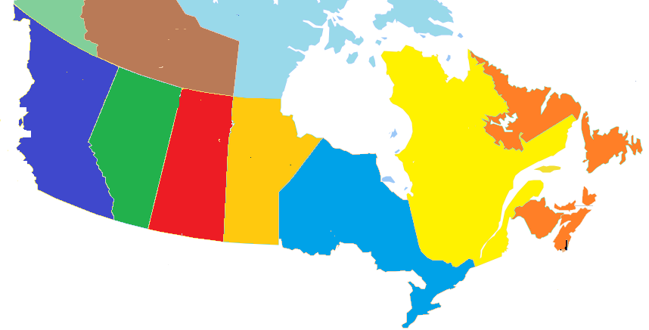
Other Canada Casino Visitors by Province of Residence
BC
0%
(7%)
Casino visits
(Total visits)
AB
7%
(7%)
SK
3%
(2%)
MB
6%
(10%)
QC
79%
(66%)
NL/NS/NB/PE
5%
(8%)
79% of Other Canada Casino visitors came from Quebec, compared to 66% of total visits
Note: Other Canada Casino visitors represented 4% (150,000) of visits and 6% ($82 M) of visitor spending
Source: Statistics Canada’s Travel Survey of the Residents of Canada and International Travel Survey 2015; Ontario Ministry of Tourism, Culture and Sport
7

Slide 8
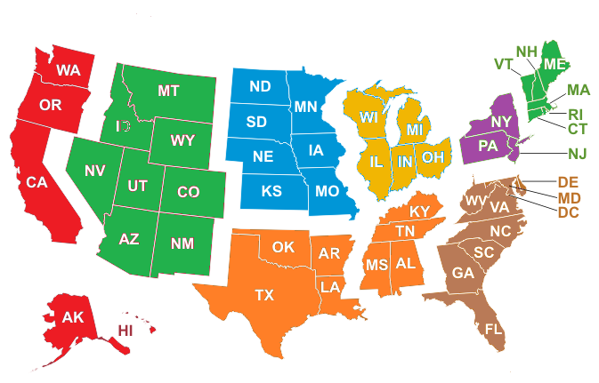
U.S. Casino Visitors by Region of Residence
Casino visits
(Total visits)
Mountain
1%
(2%)
West North Central
3%
(5%)
East North Central
34%
(39%)
New England
5%
(4%)
Pacific, Alaska, Hawaii
4%
(3%)
Mid Atlantic
39%
(36%)
South Atlantic
11%
(8%)
South Central
3%
(3%)
39% of U.S. Casino visitors came from Mid Atlantic states (New York, New Jersey, Pennsylvania) and 34% from East North Central states (Michigan, Ohio, Illinois, Indiana, and Wisconsin)
Note: U.S. Casino visitors represented 24% (870,000) of visits and 27% ($402 M) of visitor spending
Source: Statistics Canada’s Travel Survey of the Residents of Canada and International Travel Survey 2015; Ontario Ministry of Tourism, Culture and Sport
8

Slide 9
Overseas Casino Visitors by Country of Residence
Ontario’s 9 overseas target markets represent 60% of overseas Casino visitors versus 54% of total overseas visits
Note: Overseas Casino visitors represented 6% (222,000) of visits and 32% ($476 M) of visitor spending
Source: Statistics Canada’s Travel Survey of the Residents of Canada and International Travel Survey 2015; Ontario Ministry of Tourism, Culture and Sport
9

Slide 10
Destination – Casino Visits by Region
Casino vs. Total | Destination Index
Reg 1 | 113
Reg 2 | 443
Reg 3 | 92
Reg 4 | 28
Reg 5 | 82
Reg 6 | 33
Reg 7 | 133
Reg 8 | 59
Reg 9 | 72
Reg 10 | 104
Reg 11 | 31
Reg 12 | 64
Reg 13 | 34
42% of Casino visits took place in Region 2 compared to 9% of total visits, 17% in Region 5 (20% total), and 13% in Region 1 (11% total)
Source: Statistics Canada’s Travel Survey of the Residents of Canada and International Travel Survey 2015; Ontario Ministry of Tourism, Culture and Sport
10

Slide 11
Casino Visits by Length of Stay
Casino vs. Total | Length of Stay Index
Same-day | 53
Overnight | 181
Avg # nights | 121
The majority (66%) of Casino visits were overnight visits. For comparison, 36% of total visits in Ontario were overnight visits
The average number of nights spent on Casino visits was 3.8, above Ontario’s average of 3.2 nights
Source: Statistics Canada’s Travel Survey of the Residents of Canada and International Travel Survey 2015; Ontario Ministry of Tourism, Culture and Sport

Slide 12
Casino $/Trip by Length of Stay
Casino vs. Total | $/Trip Index
Total | 229
Same-day | 242
Overnight | 149
Casino visitors spent an average of $411/trip ($179/trip for total trips)
Total trip spending, not just spending on Casino
Source: Statistics Canada’s Travel Survey of the Residents of Canada and International Travel Survey 2015; Ontario Ministry of Tourism, Culture and Sport

Slide 13
Casino Spending by Category
Casino vs. Ontario | Spending Index
Transportation | 79
Accommodation | 132
Food & Beverage | 82
Rec./Entertain. | 223
Retail/Other | 81
The largest proportions of expenditures were spent on Transportation (28% Casino, 36% total), Food & Beverage (22% Casino, 27% total) and Accommodations (22% Casino, 17% total)
Source: Statistics Canada’s Travel Survey of the Residents of Canada and International Travel Survey 2015; Ontario Ministry of Tourism, Culture and Sport

Slide 14
Other Activities done by Casino Visitors
Activity | Casino Visit Participation | Index vs Total
Casinos | 100% | 3945
Cultural Performances | 22% | 556
Historic Sites | 21% | 626
Festivals/Fairs | 20% | 723
Visit Friends or Relatives | 19% | 56
Sightseeing | 18% | 300
Shopping | 17% | 184
Museums/Art Galleries | 15% | 545
Any Outdoor/Sports Activity | 12% | 70
Zoos/Aquariums/Botanical Gardens | 10% | 656
Activity | Casino Visit Participation | Index vs Total
Sports Events | 10% | 244
Restaurant or bar | 9% | 147
National/Provincial Nature Parks | 6% | 216
Boating | 4% | 110
Visit a beach | 4% | 92
Theme Parks | 4% | 316
Fishing | 3% | 103
Wildlife/Bird watching | 3% | 147
Hiking | 3% | 64
Play a sport | 2% | 82
Activity | Casino Visit Participation | Index vs Total
Canoeing | 2% | 74
Cycling | 2% | 139
Camping | 2% | 48
Business Meeting/Conference/Seminar | 1% | 34
Movies | 1% | 154
Golfing | 1% | 90
Skiing/Snowboarding | 1% | 121
Indigenous | 1% | 380
Medical/Dental appointment | 1% | 39
Cross-country Skiing | 0% | 135
Canoeing | 2% | 74
22% of Casino visitors attended a cultural performance, 21% went to a historical site, 20% visited a festival/fair
Source: Statistics Canada’s Travel Survey of the Residents of Canada and International Travel Survey 2015; Ontario Ministry of Tourism, Culture and Sport

Slide 15
Main Purpose of Casino Visit
Casino vs. Total | Purpose Index
Pleasure | 189
VFR | 47
Business | 46
Other | 79
VFR: Visiting Friends and / or Relatives
Most trips were pleasure trips (66% Casino compared to 35% of total trips)
Other includes shopping, medical, religious, hobby/trade show, etc.
Source: Statistics Canada’s Travel Survey of the Residents of Canada and International Travel Survey 2015; Ontario Ministry of Tourism, Culture and Sport

Slide 16
Casino Visits by Accommodation Type
Casino vs. Total | Type Index
Private | 63
Commercial | 160
Campground | 55
42% of overnight Casino visits were spent at commercial accommodations compared to 26% of total visits
Source: Statistics Canada’s Travel Survey of the Residents of Canada and International Travel Survey 2015; Ontario Ministry of Tourism, Culture and Sport

Slide 17
Casino Visits by Time of Year
Casino vs. Total | Quarter Index
Jan-Mar | 92
Apr-Jun | 101
Jul-Sept | 88
Oct-Dec | 120
Casino trips occur throughout the year with 28% in Oct-Dec (23% total), 27% in Jul-Sep (31% total) and 26% in Apr-Jun (26% total)
Source: Statistics Canada’s Travel Survey of the Residents of Canada and International Travel Survey 2015; Ontario Ministry of Tourism, Culture and Sport
17

Slide 18
Casino Visits by Gender
Casino vs. Total | Gender Index
Male | 107
Female | 92
Males made the majority (57%) of Casino visits. For comparison, 54% of total visits in Ontario were among male visitors
Source: Statistics Canada’s Travel Survey of the Residents of Canada and International Travel Survey 2015; Ontario Ministry of Tourism, Culture and Sport

Slide 19
Casino Visits by Party Size
Casino vs. Total | Party Size Index
1 person | 79
2 persons | 123
3+ persons | 98
Avg party size | 124
With children | 41
Avg Party Size 2.9 2.3
With children 5% 12%
46% of Casino visits were among groups of 2 people compared to 38% of total visits
5% of Casino visits included children versus 12% of total visits
Source: Statistics Canada’s Travel Survey of the Residents of Canada and International Travel Survey 2015; Ontario Ministry of Tourism, Culture and Sport
19

Slide 20
Domestic Casino Visitor’s Income
Casino vs. Total | Income Index
< $50 K | 138
$50 K- $75 K | 102
$75 K - $100 K | 84
$100 K+ | 95
34% of Canadian Casino visitors in Ontario had an household income over $100,000 compared to 36% of total visitors
Source: Statistics Canada’s Travel Survey of the Residents of Canada 2015; Ontario Ministry of Tourism, Culture and Sport

Slide 21
Domestic Casino Visitor’s Education
Casino vs. Ontario | Education Index
< High School | 131
High School | 127
Some post-secondary | 96
University degree | 82
26% of Canadian Casino visitors in Ontario had a university degree compared with 32% of total visits
Source: Statistics Canada’s Travel Survey of the Residents of Canada 2015; Ontario Ministry of Tourism, Culture and Sport

Slide 22
Casino Summary
In 2015, there were 3.6 million Casino visits in Ontario, representing 2.5% of total visits to Ontario. Casino visitors spent $1.5 billion, or 5.8% of total visitor spending in Ontario.
Ontario residents accounted for 66% of visits and 35% of spending, residents of Other Canada accounted for 4% of visits and 6% of spending, U.S. visitors represented 24% of visits and 27% of expenditures, and overseas visitors accounted for 6% of visits and 32% of spending
34% Casino visitors from Ontario are from Region 5 compared to 22% of total visits, 16% from Region 6 (14% total visits), and 14% from Region 1 (12% total visits)
42% of Casino visits took place in Region 2 compared to 9% of total visits, 17% in Region 5 (20% total), and 13% in Region 1 (11% total)

Slide 23
Casino Summary
The majority (66%) of Casino visits were overnight visits. For comparison, 36% of total visits in Ontario were overnight visits. The average number of nights spent on Casino visits was 3.8, above Ontario’s average of 3.2 nights
Casino visitors spent an average of $411/trip ($179/trip for total trips)
The largest proportions of expenditures were spent on Transportation (28% Casino, 36% total), Food & Beverage (22% Casino, 27% total) and Accommodations (22% Casino, 17% total)
22% of Casino visitors attended a cultural performance, 21% went to a historical site, 20% visited a festival/fair
Most trips were pleasure trips (66% compared to 35% of total trips)

Slide 24
Casino Summary
42% of overnight Casino visits were spent at commercial accommodations compared to 26% of total visits
Casino trips occur throughout the year with 28% in Oct-Dec (23% total), 27% in Jul-Sep (31% total) and 26% in Apr-Jun (26% total)
46% of Casino visits were among groups of 2 people compared to 38% of total visits. 5% of Casino visits included children versus 12% of total visits
34% of Canadian Casino visitors in Ontario had an household income over $100,000 compared to 36% of total visitors
26% of Canadian Casino visitors in Ontario had a university degree compared with 32% of total visits

