Slide 1
Ontario Fishing Tourism Statistics 2015
Fall 2017

Slide 2
This report summarizes key characteristics of visitors and visitor spending of trips in Ontario which included the activity of Fishing. Data was sourced from Statistics Canada’s Travel Survey of the Residents of Canada and International Travel Survey, 2015 Some slides include an index table which simplifies the comparison of Fishing and total trip statistics. Since total trips equals 100, an index of 105 indicates Fishing is 5% higher than total, similarly an index of 90 signifies Fishing is 10% lower than total. Index Interpretation less than 80 Fishing trips underdeveloped versus total trips 80-120 Fishing trips similar to total trips greater than 120 Fishing trips overdeveloped versus total trips
2

Slide 3
Visits and Spending
Region | Visits (millions) | Visitor Spending ($ billions)
Ontario Total | 141.9 | 25.4
Ontario Fishing | 4.8 | 1.2
Ontario Fishing proportion of Ontario Total | 3.4% | 4.6%
In 2015, there were 4.8 million Fishing visits in Ontario, representing 3.4% of total visits in Ontario
Fishing visitors in spent $1.2 billion, accounting for 4.6% of total visitor spending in Ontario
Source: Statistics Canada’s Travel Survey of the Residents of Canada and International Travel Survey 2015; Ontario Ministry of Tourism, Culture and Sport

Slide 4
Fishing and Total Visits by Origin
Fishing vs. Total | Visit Index
Ontario | 98
U.S. | 136
Other Canada | 92
Overseas | 43
Ontario residents accounted for the majority of Fishing (84%) and total (86%) visits
U.S. visitors accounted for 11% of Fishing visits compared to 8% of total visits
Visitors from Other Canada comprised 4% of Fishing visits and 5% of total visits
Overseas visitors accounted for 1% of Fishing visits and 2% of total visits
Source: Statistics Canada’s Travel Survey of the Residents of Canada and International Travel Survey 2015; Ontario Ministry of Tourism, Culture and Sport

Slide 5
Fishing and Total Spending by Origin
Fishing vs. Total | Spending Index
Ontario | 108
U.S. | 220
Other Canada | 42
Overseas | 25
Ontario residents accounted for the majority of Fishing (59%) and total (55%) spending
U.S. visitors accounted for 32% of Fishing spending compared to 14% of total spending
Visitors from Other Canada comprised 4% of Fishing spending and 9% of total spending
Overseas visitors accounted for 5% of Fishing spending and 22% of total spending
Source: Statistics Canada’s Travel Survey of the Residents of Canada and International Travel Survey 2015; Ontario Ministry of Tourism, Culture and Sport

Slide 6
Ontario Fishing Visitors by Region of Residence
Fishing vs. Total | Visits from Ontario Index
Reg 1 | 65
Reg 2 | 75
Reg 3 | 77
Reg 4 | 99
Reg 5 | 93
Reg 6 | 142
Reg 7 | 103
Reg 8 | 64
Reg 9 | 70
Reg 10 | 151
Reg 11 | 26
Reg 12 | 100
Reg 13 | 209
20% Fishing visitors from Ontario are from Region 5 compared to 22% of total visits, 19% from Region 6 (14% total visits), and 10% from Region 13 (5% total visits)
Note: Ontario origin Fishing visitors represented 84% (4.0 M) of visits and 59% ($691 M) of visitor spending
Source: Statistics Canada’s Travel Survey of the Residents of Canada and International Travel Survey 2015; Ontario Ministry of Tourism, Culture and Sport
6

Slide 7
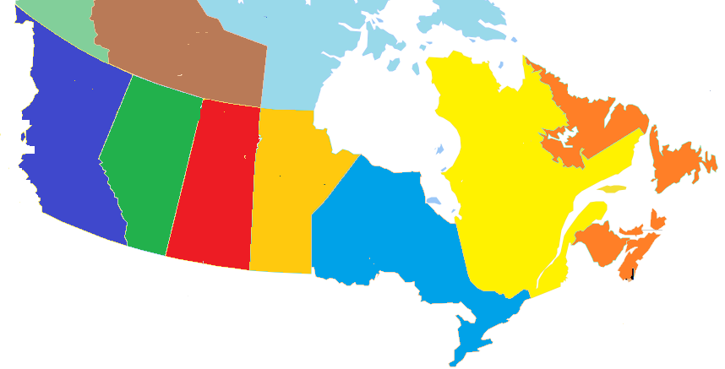
Other Canada Fishing Visitors by Province of Residence
BC
2%
(7%)
Fishing visits
(Total visits)
AB
6%
(7%)
SK
3%
(2%)
MB
68%
(10%)
QC
18%
(66%)
NL/NB/NS/PE
3%
(8%)
68% of Other Canada Fishing visitors came from Manitoba with 59% from Winnipeg, (total visits Manitoba 10%, Winnipeg 9%)
Note: Other Canada Fishing visitors represented 4% (202,000) of visits and 4% ($44 M) of visitor spending
Source: Statistics Canada’s Travel Survey of the Residents of Canada and International Travel Survey 2015; Ontario Ministry of Tourism, Culture and Sport
7

Slide 8
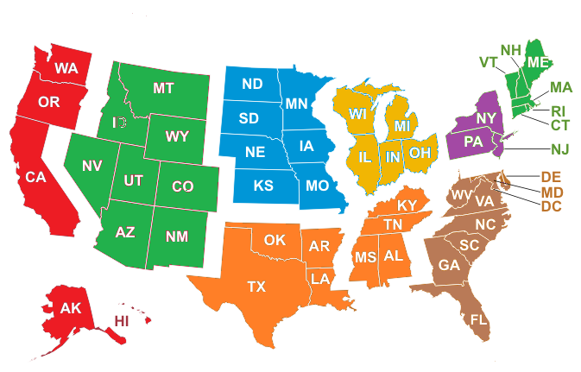
U.S. Fishing Visitors by Region of Residence
Fishing visits
(Total visits)
Mountain
3%
(2%)
West North Central
33%
(5%)
East North Central
31%
(39%)
New England
1%
(4%)
Pacific, Alaska, Hawaii
3%
(3%)
Mid Atlantic
20%
(36%)
South Atlantic
6%
(8%)
South Central
3%
(3%)
33% of U.S. Fishing visitors came from West North Central states and 31% from East North Central states
Note: U.S. Fishing visitors represented 11% (521,000) of visits and 32% ($366 M) of visitor spending
Source: Statistics Canada’s Travel Survey of the Residents of Canada and International Travel Survey 2015; Ontario Ministry of Tourism, Culture and Sport
8

Slide 9
Overseas Fishing Visitors by Country of Residence
Ontario’s 9 overseas target markets represent 60% of overseas Fishing visitors and 54% of total overseas visits
Note: Overseas Fishing visitors represented 1% (37,000) of visits and 5% ($62 M) of visitor spending
Source: Statistics Canada’s Travel Survey of the Residents of Canada and International Travel Survey 2015; Ontario Ministry of Tourism, Culture and Sport
9

Slide 10
Destination – Fishing Visits by Region
Fishing vs. Total | Destination Index
Reg 1 | 46
Reg 2 | 32
Reg 3 | 11
Reg 4 | 50
Reg 5 | 16
Reg 6 | 29
Reg 7 | 149
Reg 8 | 265
Reg 9 | 115
Reg 10 | 27
Reg 11 | 400
Reg 12 | 421
Reg 13 | 358
23% of Fishing visits took place in Region 13 compared to 6% of total visits, 15% in Region 11 (4% total), and 13% in Region 12 (3% total)
Source: Statistics Canada’s Travel Survey of the Residents of Canada and International Travel Survey 2015; Ontario Ministry of Tourism, Culture and Sport
10

Slide 11
Fishing Visits by Length of Stay
Fishing vs. Total | Length of Stay Index
Same-day | 40
Overnight | 204
Avg # nights | 128
The majority (74%) of Fishing visits were overnight visits. For comparison, 36% of total visits in Ontario were overnight visits
The average number of nights spent on Fishing visits was 4.0, above Ontario’s average of 3.2 nights
Source: Statistics Canada’s Travel Survey of the Residents of Canada and International Travel Survey 2015; Ontario Ministry of Tourism, Culture and Sport

Slide 12
Fishing $/Trip by Length of Stay
Fishing vs. Total | $/Trip Index
Total | 137
Same-day | 153
Overnight | 82
Fishing visitors spent an average of $245/trip ($179/trip for total trips)
On average, overnight visitors spent over twice as much per trip as same-day visitors
Total trip spending, not just spending on Fishing
Source: Statistics Canada’s Travel Survey of the Residents of Canada and International Travel Survey 2015; Ontario Ministry of Tourism, Culture and Sport

Slide 13
Fishing Spending by Category
Fishing vs. Ontario | Spending Index
Transportation | 71
Accommodation | 175
Food & Beverage | 110
Rec./Entertain. | 100
Retail/Other | 62
The largest proportions of expenditures were spent on Transportation (26% Fishing, 36% total), Food & Beverage (30% Fishing, 27% total) and Accommodations (29% Fishing, 17% total)
Source: Statistics Canada’s Travel Survey of the Residents of Canada and International Travel Survey 2015; Ontario Ministry of Tourism, Culture and Sport

Slide 14
Other Activities done by Fishing Visitors
Activity | Fishing Visit Participation | Index vs Total
Any Outdoor/Sports Activity | 100% | 582
Fishing | 100% | 2985
Boating | 50% | 1246
Visit a beach | 27% | 614
Canoeing | 27% | 1206
Hiking | 22% | 507
Camping | 20% | 625
Wildlife/Bird watching | 16% | 692
National/Provincial Nature Parks | 7% | 254
Visit Friends or Relatives | 7% | 21
Activity | Fishing Visit Participation | Index vs Total
Golfing | 6% | 438
Restaurant or bar | 6% | 87
Shopping | 5% | 56
Cycling | 5% | 423
Play a sport | 4% | 193
Sightseeing | 4% | 68
Historic Sites | 4% | 122
Festivals/Fairs | 4% | 140
Hunting | 3% | 708
Museums/Art Galleries | 3% | 108
Activity | Fishing Visit Participation | Index vs Total
Casinos | 3% | 103
Sports Events | 2% | 44
Snowmobiling | 2% | 655
ATV | 1% | 588
Cultural Performances | 1% | 33
Zoos/Aquariums/Botanical Gardens | 1% | 62
Cross-country Skiing | 1% | 224
Theme Parks | 1% | 58
Movies | 1% | 73
Indigenous | 1% | 298
50% of Fishing visitors went boating, 27% visited a beach, and 27% went canoeing
Source: Statistics Canada’s Travel Survey of the Residents of Canada and International Travel Survey 2015; Ontario Ministry of Tourism, Culture and Sport

Slide 15
Main Purpose of Fishing Visit
Fishing vs. Total | Purpose Index
Pleasure | 229
VFR | 36
Business | 9
Other | 17
VFR: Visiting Friends and / or Relatives
Most trips were pleasure trips (81% compared to 35% of total trips)
Other includes shopping, medical, religious, hobby/trade show, etc.
Source: Statistics Canada’s Travel Survey of the Residents of Canada and International Travel Survey 2015; Ontario Ministry of Tourism, Culture and Sport

Slide 16
Fishing Visits by Accommodation Type
Fishing vs. Total | Type Index
Private | 89
Commercial | 100
Campground | 257
The majority (55%) of overnight Fishing visits were spent at unpaid accommodations such as private homes and cottages, compared to 61% of total visits
14% of overnight Fishing visits were spent in camping/RV facilities versus 5% of total visits
Source: Statistics Canada’s Travel Survey of the Residents of Canada and International Travel Survey 2015; Ontario Ministry of Tourism, Culture and Sport

Slide 17
Fishing Visits by Time of Year
Fishing vs. Total | Quarter Index
Jan-Mar | 37
Apr-Jun | 125
Jul-Sept | 179
Oct-Dec | 22
The largest proportion of trips occur in the summer months with 55% of Fishing trips taking place in Jul-Sep versus 31% of total trips
Source: Statistics Canada’s Travel Survey of the Residents of Canada and International Travel Survey 2015; Ontario Ministry of Tourism, Culture and Sport
17

Slide 18
Fishing Visits by Gender
Fishing vs. Total | Gender Index
Male | 123
Female | 73
Males made the majority (66%) of Fishing visits. For comparison, 54% of total visits in Ontario were among male visitors
Source: Statistics Canada’s Travel Survey of the Residents of Canada and International Travel Survey 2015; Ontario Ministry of Tourism, Culture and Sport

Slide 19
Fishing Visits by Party Size
Fishing vs. Total | Party Size Index
1 person | 58
2 persons | 96
3+ persons | 175
Avg party size | 129
With children | 156
Avg Party Size 3.0 2.3
With children 19% 12%
41% of Fishing visits were among groups of 3 or more people compared to 24% of total visits
19% of Fishing visits included children versus 12% of total visits
Source: Statistics Canada’s Travel Survey of the Residents of Canada and International Travel Survey 2015; Ontario Ministry of Tourism, Culture and Sport
19

Slide 20
Domestic Fishing Visitor’s Income
Fishing vs. Total | Income Index
< $50 K | 86
$50 K- $75 K | 99
$75 K - $100 K | 99
$100 K+ | 108
39% of Canadian Fishing visitors in Ontario had an household income greater than $100,000 compared to 36% of total visitors
Source: Statistics Canada’s Travel Survey of the Residents of Canada 2015; Ontario Ministry of Tourism, Culture and Sport

Slide 21
Domestic Fishing Visitor’s Education
Fishing vs. Ontario | Education Index
< High School | 83
High School | 121
Some post-secondary | 107
University degree | 82
27% of Canadian Fishing visitors in Ontario had a university degree compared with 32% of total visits
Source: Statistics Canada’s Travel Survey of the Residents of Canada 2015; Ontario Ministry of Tourism, Culture and Sport

Slide 22
Fishing Summary
In 2015, there were 4.8 million Fishing visits, accounting for 3.4% of total visits to Ontario. Fishing visitors spent $1.2 billion, or 4.6% of total visitor spending in Ontario.
Ontario residents accounted for 84% of visits and 59% of spending, residents of Other Canada accounted for 4% of visits and 4% of spending, U.S. visitors represented 11% of visits and 32% of expenditures, and overseas visitors accounted for 1% of visits and 5% of spending
20% Fishing visitors from Ontario are from Region 5 compared to 22% of total visits, 19% from Region 6 (14% total visits), and 10% from Region 13 (5% total visits)
23% of Fishing visits took place in Region 13 compared to 6% of total visits, 15% in Region 11 (4% total), and 13% in Region 12 (3% total)

Slide 23
Fishing Summary
The majority (74%) of Fishing visits were overnight visits. For comparison, 36% of total visits in Ontario were overnight visits. The average number of nights spent on Fishing visits was 4.0, above Ontario’s average of 3.2 nights
Fishing visitors spent an average of $245/trip ($179/trip for total trips). On average, overnight visitors spent over twice as much per trip as same-day visitors
The largest proportions of expenditures were spent on Transportation (26% Fishing, 36% total), Food & Beverage (30% Fishing, 27% total) and Accommodations (29% Fishing, 17% total)
50% of Fishing visitors went boating, 27% visited a beach, and 27% went canoeing
Most trips were pleasure trips (81% compared to 35% of total trips)

Slide 24
Fishing Summary
The majority (55%) of overnight Fishing visits were spent at unpaid accommodations such as private homes and cottages, compared to 61% of total visits. 14% of overnight Fishing visits were spent in camping/RV facilities versus 5% of total visits
The largest proportion of trips occur in the summer months with 55% of Fishing trips taking place in Jul-Sep versus 31% of total trips
41% of Fishing visits were among groups of 3 or more people compared to 24% of total visits. 19% of Fishing visits included children versus 12% of total visits
39% of Canadian Fishing visitors in Ontario had an household income greater than $100,000 compared to 36% of total visitors
27% of Canadian Fishing visitors in Ontario had a university degree compared with 32% of total visits

