Slide 1
Ontario Theme Park Tourism Statistics 2015
Fall 2017

Slide 2
This report summarizes key characteristics of visitors and visitor spending of trips in Ontario which included visiting a theme or amusement park. Data was sourced from Statistics Canada’s Travel Survey of the Residents of Canada and International Travel Survey, 2015 Some slides include an index table which simplifies the comparison of Theme Park and total trip statistics. Since total trips equals 100, an index of 105 indicates Theme Park is 5% higher than total, similarly an index of 90 signifies Theme Park is 10% lower than total. Index Interpretation less than 80 Theme Park trips underdeveloped versus total trips 80-120 Theme Park trips similar to total trips greater than 120 Theme Park trips overdeveloped versus total trips
2

Slide 3
Visits and Spending
Region | Visits (millions) | Visitor Spending ($ billions)
Ontario Total | 141.9 | 25.4
Ontario Theme Park | 1.7 | 0.9
Ontario Theme Park proportion of Ontario Total | 1.2% | 3.6%
In 2015, there were 1.7 million Theme Park visits in Ontario, representing 1.2% of total visits in Ontario
Theme Park visitors spent $926 million, accounting for 3.6% of total visitor spending in Ontario
Source: Statistics Canada’s Travel Survey of the Residents of Canada and International Travel Survey 2015; Ontario Ministry of Tourism, Culture and Sport

Slide 4
Theme Park and Total Visits by Origin
Theme Park vs. Total | Visit Index
Ontario | 82
U.S. | 59
Other Canada | 305
Overseas | 616
Ontario residents accounted for the majority of Theme Park (70%) and total (86%) visits
U.S. visitors accounted for 5% of Theme Park visits compared to 8% of total visits
Visitors from Other Canada comprised 14% of Theme Park visits and 5% of total visits
Overseas visitors accounted for 11% of Theme Park visits and 2% of total visits
Source: Statistics Canada’s Travel Survey of the Residents of Canada and International Travel Survey 2015; Ontario Ministry of Tourism, Culture and Sport

Slide 5
Theme Park and Total Spending by Origin
Theme Park vs. Total | Spending Index
Ontario | 73
U.S. | 43
Other Canada | 182
Overseas | 173
Ontario residents accounted for the 40% of Theme Park and 55% of total spending
U.S. visitors accounted for 6% of Theme Park spending compared to 14% of total spending
Visitors from Other Canada comprised 16% of Theme Park spending and 9% of total spending
Overseas visitors accounted for 37% of Theme Park spending and 22% of total spending
Source: Statistics Canada’s Travel Survey of the Residents of Canada and International Travel Survey 2015; Ontario Ministry of Tourism, Culture and Sport

Slide 6
Ontario Theme Park Visitors by Region of Residence
Theme Park vs. Total | Visits from Ontario Index
Reg 1 | 123
Reg 2 | 71
Reg 3 | 166
Reg 4 | 106
Reg 5 | 98
Reg 6 | 84
Reg 7 | 46
Reg 8 | 76
Reg 9 | 134
Reg 10 | 96
Reg 11 | 89
Reg 12 | 22
Reg 13 | 60
21% Theme Park visitors from Ontario are from Region 5 compared to 22% of total visits, 18% from Region 3 (11% total visits), and 14% from Region 1 (12% total visits)
Note: Ontario origin Theme Park visitors represented 70% (1.2 M) of visits and 40% ($370 M) of visitor spending
Source: Statistics Canada’s Travel Survey of the Residents of Canada and International Travel Survey 2015; Ontario Ministry of Tourism, Culture and Sport
6

Slide 7
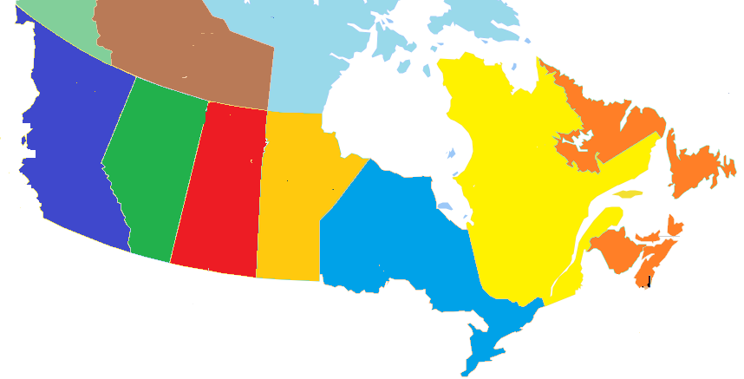
Other Canada Theme Park Visitors by Province of Residence
BC
7%
(7%)
Theme Park visits
(Total visits)
AB
8%
(7%)
SK
5%
(2%)
MB
4%
(10%)
QC
67%
(66%)
NL/NB/NS/PE
9%
(8%)
67% of Other Canada Theme Park visitors came from Quebec with 39% from Montreal, similar to total visits (Quebec 65%, Montreal 43%)
Note: Other Canada Theme Park visitors represented 14% (233,000) of visits and 16% ($153M) of visitor spending
Source: Statistics Canada’s Travel Survey of the Residents of Canada and International Travel Survey 2015; Ontario Ministry of Tourism, Culture and Sport
7

Slide 8
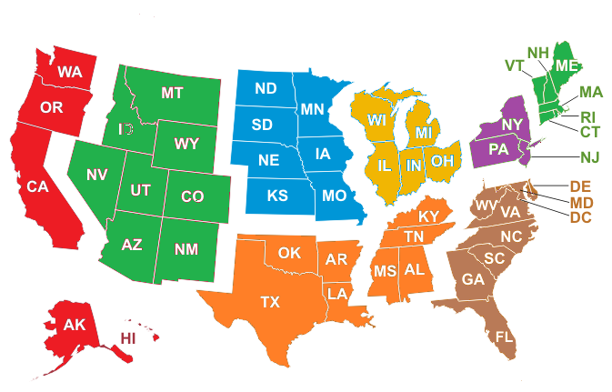
U.S. Theme Park Visitors by Region of Residence
Theme Park visits
(Total visits)
Mountain
1%
(2%)
West North Central
0%
(5%)
East North Central
13%
(39%)
New England
8%
(4%)
Pacific, Alaska, Hawaii
17%
(3%)
Mid Atlantic
14%
(36%)
South Atlantic
30%
(8%)
South Central
18%
(3%)
30% of U.S. Theme Park visitors came from South Atlantic states 18% from South Central states
Note: U.S. Theme Park visitors represented 5% (79,000) of visits and 6% ($57 M) of visitor spending
Source: Statistics Canada’s Travel Survey of the Residents of Canada and International Travel Survey 2015; Ontario Ministry of Tourism, Culture and Sport
8

Slide 9
Overseas Theme Park Visitors by Country of Residence
Ontario’s 9 overseas target markets represent 60% of overseas Theme Park visitors versus 54% of total overseas visits
Note: Overseas Theme Park visitors represented 11% (185,000) of visits and 37% ($346 M) of visitor spending
Source: Statistics Canada’s Travel Survey of the Residents of Canada and International Travel Survey 2015; Ontario Ministry of Tourism, Culture and Sport
9

Slide 10
Destination – Theme Park Visits by Region
Theme Park vs. Total | Destination Index
Reg 1 | 48
Reg 2 | 375
Reg 3 | 25
Reg 4 | 46
Reg 5 | 136
Reg 6 | 201
Reg 7 | 69
Reg 8 | 21
Reg 9 | 83
Reg 10 | 181
Reg 11 | 22
Reg 12 | 81
Reg 13 | 41
35% of Theme Park visits took place in Region 2 compared to 9% of total visits, 28% in Region 5 (20% total), and 16% in Region 6 (8% total)
Source: Statistics Canada’s Travel Survey of the Residents of Canada and International Travel Survey 2015; Ontario Ministry of Tourism, Culture and Sport
10

Slide 11
Theme Park Visits by Length of Stay
Theme Park vs. Total | Length of Stay Index
Same-day | 58
Overnight | 173
Avg # nights | 167
The majority (63%) of Theme Park visits were overnight visits. For comparison, 36% of total visits in Ontario were overnight visits
The average number of nights spent on Theme Park visits was 5.3, above Ontario’s average of 3.2 nights
Source: Statistics Canada’s Travel Survey of the Residents of Canada and International Travel Survey 2015; Ontario Ministry of Tourism, Culture and Sport

Slide 12
Theme Park $/Trip by Length of Stay
Theme Park vs. Total | $/Trip Index
Total | 311
Same-day | 225
Overnight | 223
Theme Park visitors spent an average of $558/trip ($179/trip for total trips)
On average, overnight visitors spent over 4 times as much per trip as same-day visitors
Total trip spending, not just spending on Theme Park
Source: Statistics Canada’s Travel Survey of the Residents of Canada and International Travel Survey 2015; Ontario Ministry of Tourism, Culture and Sport

Slide 13
Theme Park Spending by Category
Theme Park vs. Ontario | Spending Index
Transportation | 81
Accommodation | 119
Food & Beverage | 90
Rec./Entertain. | 183
Retail/Other | 102
The largest proportions of expenditures were spent on Transportation (29% Theme Park, 36% total) and Food & Beverage (24% Theme Park, 27% total)
Theme Park visitors spent a larger proportion on accommodations, 20%, than total visitors, 17%
Source: Statistics Canada’s Travel Survey of the Residents of Canada and International Travel Survey 2015; Ontario Ministry of Tourism, Culture and Sport

Slide 14
Other Activities done by Theme Park Visitors
Activity | Theme Park Visit Participation | Index vs Total
Theme Parks | 100% | 8543
Any Outdoor/Sports Activity | 25% | 144
Sightseeing | 21% | 352
Historic Sites | 21% | 627
Shopping | 19% | 214
National/Provincial Nature Parks | 19% | 684
Museums/Art Galleries | 18% | 625
Restaurant or bar | 17% | 266
Zoos/Aquariums/Botanical Gardens | 16% | 1008
Visit Friends or Relatives | 13% | 40
Activity | Theme Park Visit Participation | Index vs Total
Visit a beach | 10% | 224
Hiking | 10% | 219
Wildlife/Bird watching | 9% | 390
Casinos | 8% | 316
Boating | 8% | 190
Sports Events | 6% | 139
Festivals/Fairs | 6% | 204
Cycling | 6% | 480
Cultural Performances | 5% | 133
Camping | 5% | 164
Activity | Theme Park Visit Participation | Index vs Total
Play a sport | 4% | 200
Canoeing | 4% | 170
Movies | 4% | 422
Golfing | 3% | 225
Skiing/Snowboarding | 2% | 337
Fishing | 2% | 58
Indigenous | 2% | 878
Medical/Dental appointment | 1% | 109
Business Meeting/Conference/Seminar | 1% | 26
Cross-country Skiing | 1% | 292
21% of Theme Park visitors went to sightseeing, 21% went to a historic site, and 19% went to a park
Source: Statistics Canada’s Travel Survey of the Residents of Canada and International Travel Survey 2015; Ontario Ministry of Tourism, Culture and Sport

Slide 15
Main Purpose of Theme Park Visit
Theme Park vs. Total | Purpose Index
Pleasure | 206
VFR | 46
Business | 18
Other | 44
VFR: Visiting Friends and / or Relatives
Most trips were pleasure trips (73% compared to 35% of total trips)
Other includes shopping, medical, religious, hobby/trade show, etc.
Source: Statistics Canada’s Travel Survey of the Residents of Canada and International Travel Survey 2015; Ontario Ministry of Tourism, Culture and Sport

Slide 16
Theme Park Visits by Accommodation Type
Theme Park vs. Total | Type Index
Private | 82
Commercial | 134
Campground | 63
The majority (50%) of overnight Theme Park visits were spent at unpaid accommodations such as private homes and cottages, compared to 61% of total visits
35% of overnight Theme Park visits were spent in commercial accommodations versus 26% of total visits
Source: Statistics Canada’s Travel Survey of the Residents of Canada and International Travel Survey 2015; Ontario Ministry of Tourism, Culture and Sport

Slide 17
Theme Park Visits by Time of Year
Theme Park vs. Total | Quarter Index
Jan-Mar | 39
Apr-Jun | 79
Jul-Sept | 204
Oct-Dec | 38
The largest proportion of trips occur in the summer months with 63% of Theme Park trips taking place in Jul-Sep versus 31% of total trips
Source: Statistics Canada’s Travel Survey of the Residents of Canada and International Travel Survey 2015; Ontario Ministry of Tourism, Culture and Sport
17

Slide 18
Theme Park Visits by Gender
Theme Park vs. Total | Gender Index
Male | 99
Female | 101
Males made the majority (53%) of Theme Park visits. For comparison, 54% of total visits in Ontario were among male visitors
Source: Statistics Canada’s Travel Survey of the Residents of Canada and International Travel Survey 2015; Ontario Ministry of Tourism, Culture and Sport

Slide 19
Theme Park Visits by Party Size
Theme Park vs. Total | Party Size Index
1 person | 33
2 persons | 81
3+ persons | 241
Avg party size | 154
With children | 317
Avg Party Size 3.6 2.3
With children 40% 12%
57% of Theme Park visits were among groups of 3 or more people compared to 24% of total visits
40% of Theme Park visits included children versus 12% of total visits
Source: Statistics Canada’s Travel Survey of the Residents of Canada and International Travel Survey 2015; Ontario Ministry of Tourism, Culture and Sport
19

Slide 20
Domestic Theme Park Visitor’s Income
Theme Park vs. Total | Income Index
< $50 K | 75
$50 K- $75 K | 125
$75 K - $100 K | 120
$100 K+ | 92
33% of Canadian Theme Park visitors in Ontario had an household income greater than $100,000 compared to 36% of total visitors
Source: Statistics Canada’s Travel Survey of the Residents of Canada 2015; Ontario Ministry of Tourism, Culture and Sport

Slide 21
Domestic Theme Park Visitor’s Education
Theme Park vs. Ontario | Education Index
< High School | 59
High School | 110
Some post-secondary | 103
University degree | 98
32% of Canadian Theme Park visitors in Ontario had a university degree similar to total visits
Source: Statistics Canada’s Travel Survey of the Residents of Canada 2015; Ontario Ministry of Tourism, Culture and Sport

Slide 22
Theme Park Summary
In 2015, there were 1.7 million Theme Park visits, accounting for 1.2% of total visits in Ontario. Theme Park visitors spent $926 million, or 3.6% of total visitor spending in Ontario.
Ontario residents accounted for 70% of visits and 40% of spending, residents of Other Canada accounted for 14% of visits and 16% of spending, U.S. visitors represented 5% of visits and 6% of expenditures, and overseas visitors accounted for 11% of visits and 37% of spending
21% Theme Park visitors from Ontario are from Region 5 compared to 22% of total visits, 18% from Region 3 (11% total visits), and 14% from Region 1 (12% total visits)
35% of Theme Park visits took place in Region 2 compared to 9% of total visits, 28% in Region 5 (20% total), and 16% in Region 6 (8% total)

Slide 23
Theme Park Summary
The majority (63%) of Theme Park visits were overnight visits. For comparison, 36% of total visits in Ontario were overnight visits. The average number of nights spent on Theme Park visits was 5.3, above Ontario’s average of 3.2 nights
Theme Park visitors spent an average of $558/trip ($179/trip for total trips). On average, overnight visitors spent over four times as much per trip as same-day visitors
The largest proportions of expenditures were spent on Transportation (29% Theme Park, 36% total) and Food & Beverage (24% Theme Park, 27% total). Theme Park visitors spent a larger proportion on accommodations, 20%, than total visitors, 17%
21% of Theme Park visitors went to sightseeing, 21% went to a historic site, and 19% went to a park
Most trips were pleasure trips (73% compared to 35% of total trips)

Slide 24
Theme Park Summary
The majority (50%) of overnight Theme Park visits were spent at unpaid accommodations such as private homes and cottages, compared to 61% of total visits. 35% of overnight Theme Park visits were spent in commercial accommodations versus 26% of total visits
The largest proportion of trips occur in the summer months with 63% of Theme Park trips taking place in Jul-Sep versus 31% of total trips
57% of Theme Park visits were among groups of 3 or more people compared to 24% of total visits. 40% of Theme Park visits included children versus 12% of total visits
33% of Canadian Theme Park visitors in Ontario had an household income greater than $100,000 compared to 36% of total visitors
32% of Canadian Theme Park visitors in Ontario had a university degree similar to total visits

